Slide 1



A320 FFS
Maintenance Technicians
Training Course
Motion cabinet
Prepared By: Mohamed Sakr
Maintenance Operating Control Unit (MOCU)
Maintenance Operating Display Unit (MODU)
Thales Training & Simulation
Notes:
Motion - Electronics
23-Apr-02
Instructor Notes
TTSL Prod Training Department

Slide 2
Motion Cabinet
Contains the electronics required to operate the following parts of the motion system:
  Actuators
  Safety systems
  Drawbridge
  Maintenance Operator’s Control Unit
  Hydraulic Power Unit
Notes:
Motion - Electronics
23-Apr-02
Instructor Notes
TTSL Prod Training Department

Slide 3
Controlled Units
Drawbridge Control
Motion
Cabinet
Safety Interlocks
Feedback
SERVO
VALVE
Actuators
Hydraulic Power Unit
Notes:
Motion - Electronics
23-Apr-02
Instructor Notes
TTSL Prod Training Department

Slide 4
Motion Cabinet Layout
Maintenance Operators
Display Unit (MODU)
Maintenance Operators
Control Unit (MOCU)
Power Distribution Panel
(MCa)
Motion Crate
Repadis (MCc)
Latency Panel
(MCd)
Notes:
Motion - Electronics
23-Apr-02
Instructor Notes
TTSL Prod Training Department

Slide 5
Motion Cabinet Layout (MC rear)
Motion Interlock Panel
(MCe)
REAR
Notes:
Motion - Electronics
23-Apr-02
Instructor Notes
TTSL Prod Training Department

Slide 6
Maintenance Operators Station
Software running on Host
  Operates the Maintenance Operators Display Unit (MODU) via the IOS. This display unit allows the operator access to maintenance, status and calibration pages for the Motion system.
Notes:
Motion - Electronics
23-Apr-02
Instructor Notes
TTSL Prod Training Department

Slide 7
MODU Software Structure
Three position Key Switch
MAINTENANCE
KEY
SWITCH
NORMAL
OFF (DIAGNOSTICS)
Notes:
Motion - Electronics
23-Apr-02
Instructor Notes
TTSL Prod Training Department

Slide 8
Motion Safety & Engagement
The Safety Software has two main functions.
They are to ensure:-
  1. The Motion system is safe to be engaged.
  2. The Motion system can be shutdown quickly
  and safely in the event of an emergency.
The Safety Software will check the following conditions prior to allowing the motion to be engaged:-
  1. The HPU is running correctly
  2. The Motion interlocks are all closed
Notes:
Motion - Electronics
23-Apr-02
Instructor Notes
TTSL Prod Training Department
Add info

Slide 9
Motion System Engagement
The Safety Software will check that all conditions are satisfactory to allow the motion to be engaged from one of the following:-
  1. IOS Motion engage pushbutton
  2. MOCU Motion engage pushbutton
  3. MODU Touch screen display
Notes:
Motion - Electronics
23-Apr-02
Instructor Notes
TTSL Prod Training Department

Slide 10
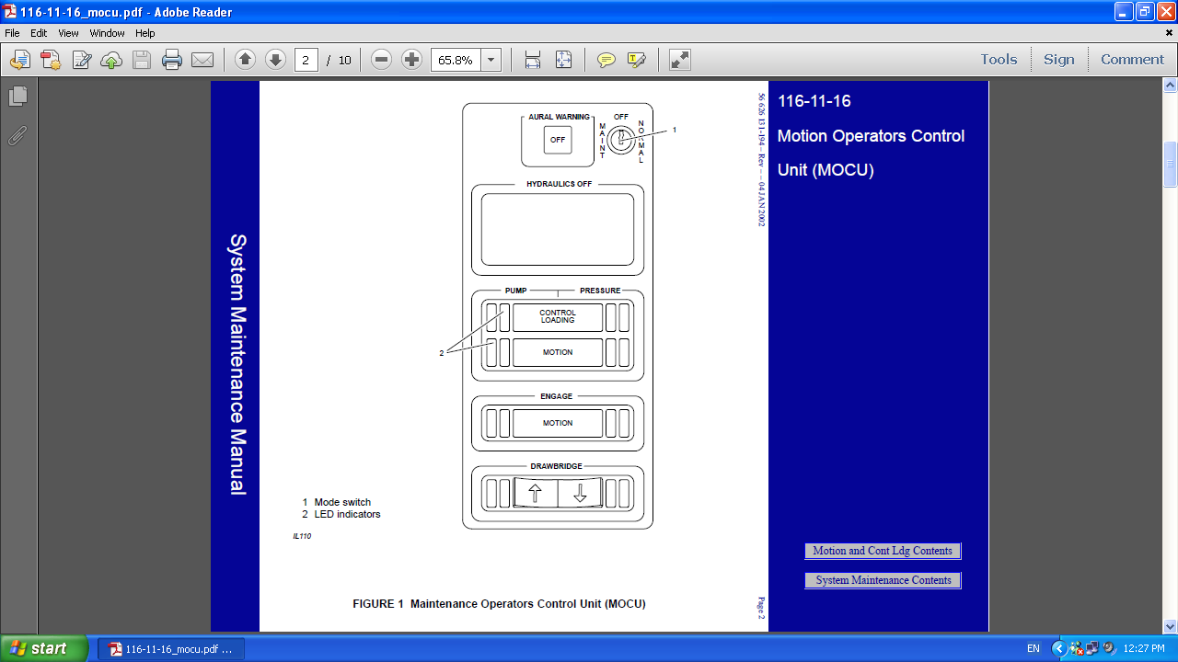

Slide 11
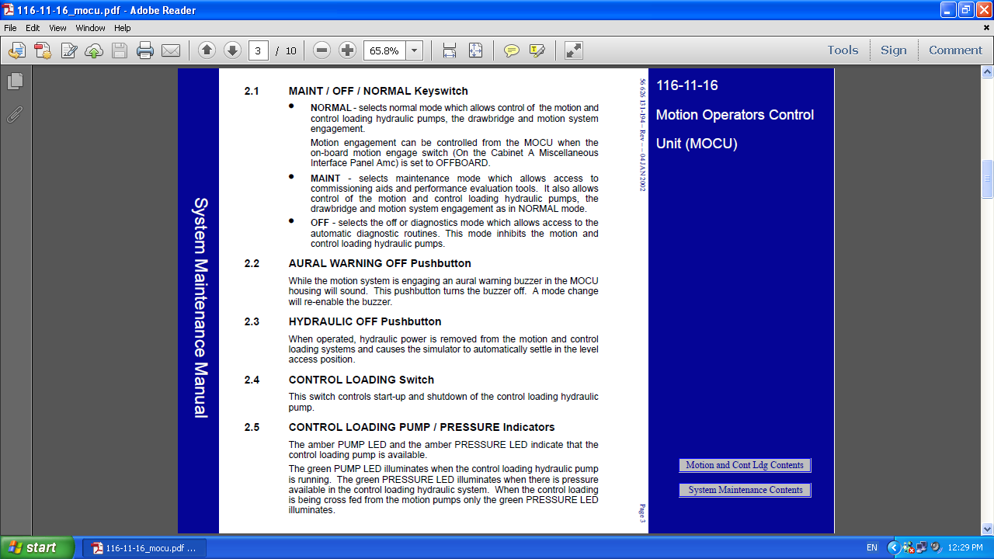

Slide 12
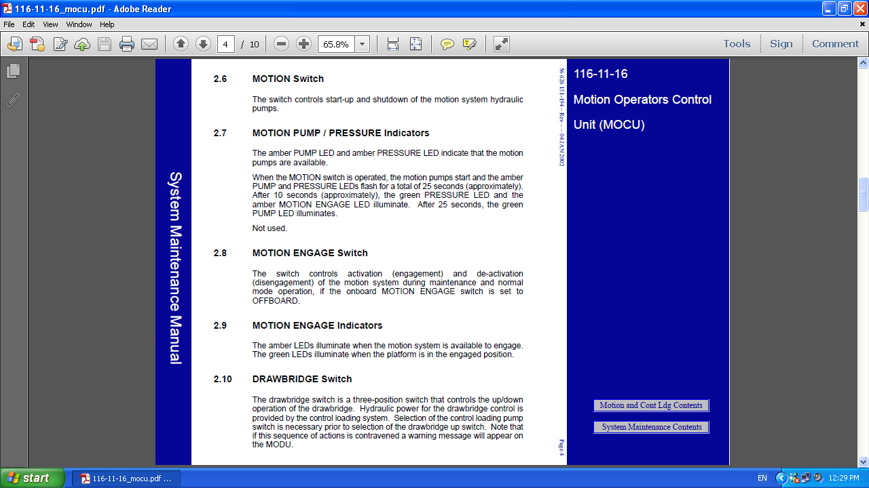

Slide 13
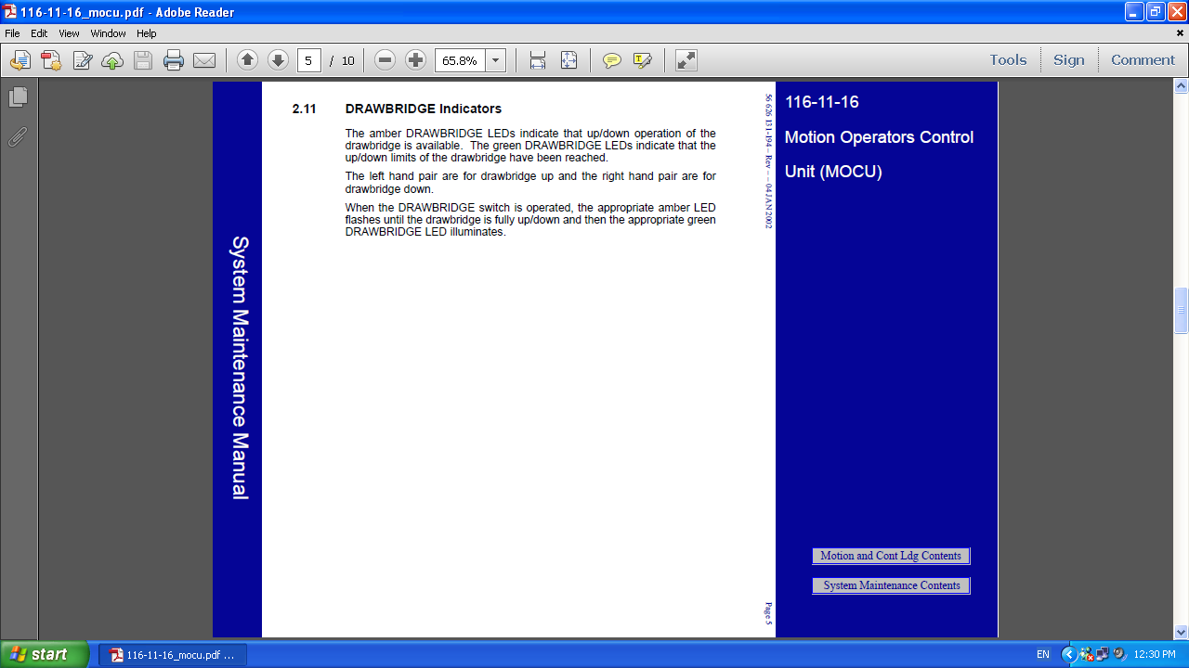

Slide 14
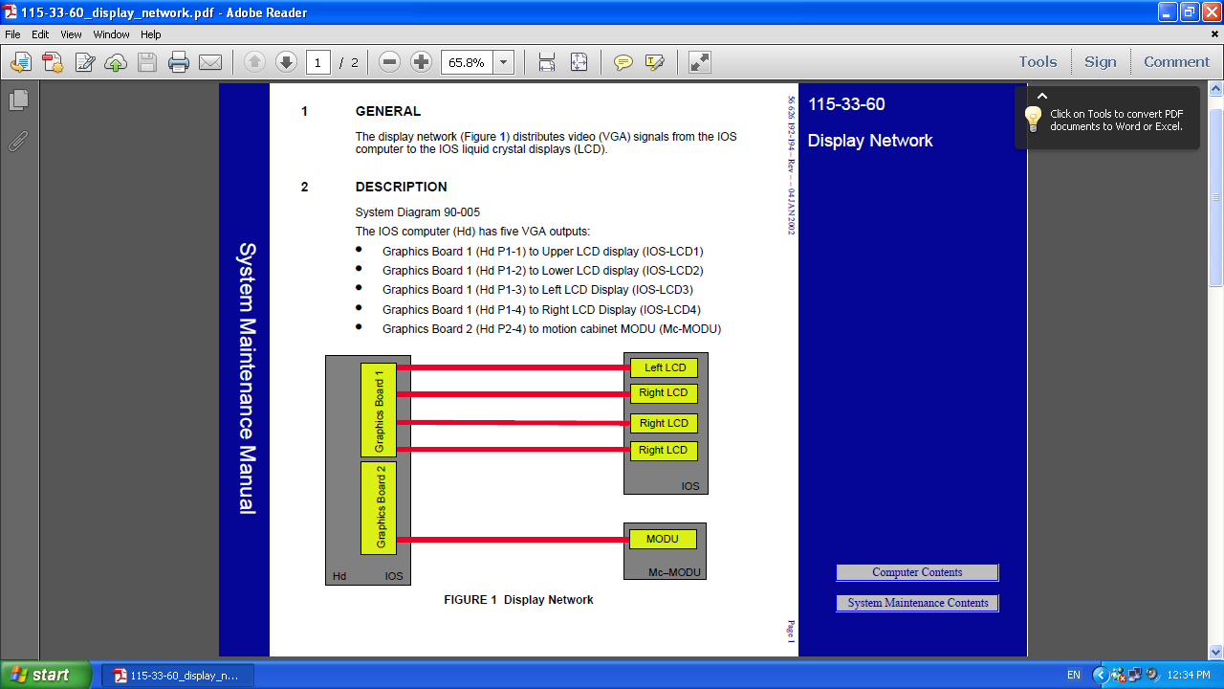

Slide 15
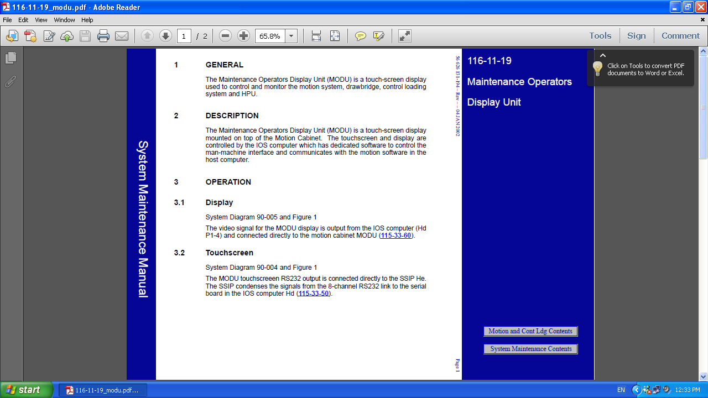

Slide 16


References : THALES STD simulator Manufacture manual .
?
Please Feel free to Ask
Practical

